Slide 1

POKEMON CLUSTERING USING HIERARCHIAL AGGLOMERATIVE CLUSTERING
By Lakshmi Sai Srikar Vadlamani (2K19/CO/208)
Jayant Rana (2K19/CO/177)

Slide 2
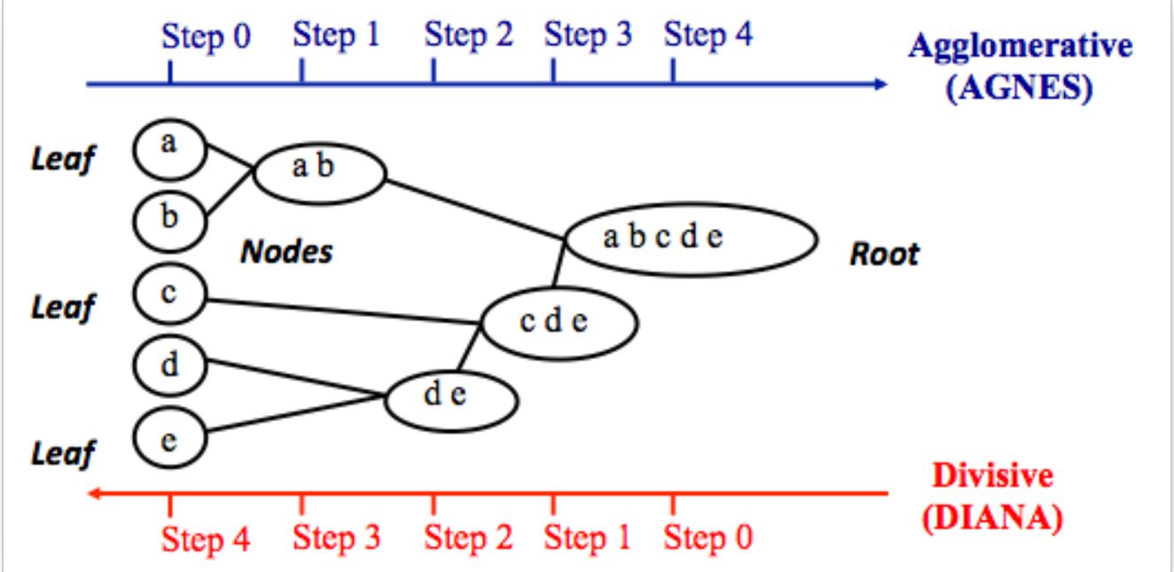
Hierarchial AGGLOMERATIVE CLUSTERING (HAC)
Agglomerative clustering works in a “bottom-up” manner. That is, each object is initially considered as a single-element cluster (leaf). At each step of the algorithm, the two clusters that are the most similar are combined into a new bigger cluster (nodes). This procedure is iterated until all points are member of just one single big cluster (root) (see figure below).

Slide 3
The IDEA
Using the Pokemon stats available in the csv file, we'll be performing clustering on these stats.
Each Pokemon is defined by a row in the data set. Because there are various ways to characterize how strong a Pokemon is, it is often desirable to convert a raw stats sheet into a shorter feature vector.
In this project, we will represent a Pokemon's strength by two numbers: "x" and "y".
"x" will represent the Pokemon's total offensive strength, which is defined by Attack + Sp. Atk + Speed.
Similarly, "y" will represent the Pokemon's total defensive strength, which is defined by Defense + Sp. Def + HP.
After each Pokemon becomes that two-dimensional feature vector, we will cluster the first 20 Pokemon with hierarchical agglomerative clustering (HAC).

Slide 4
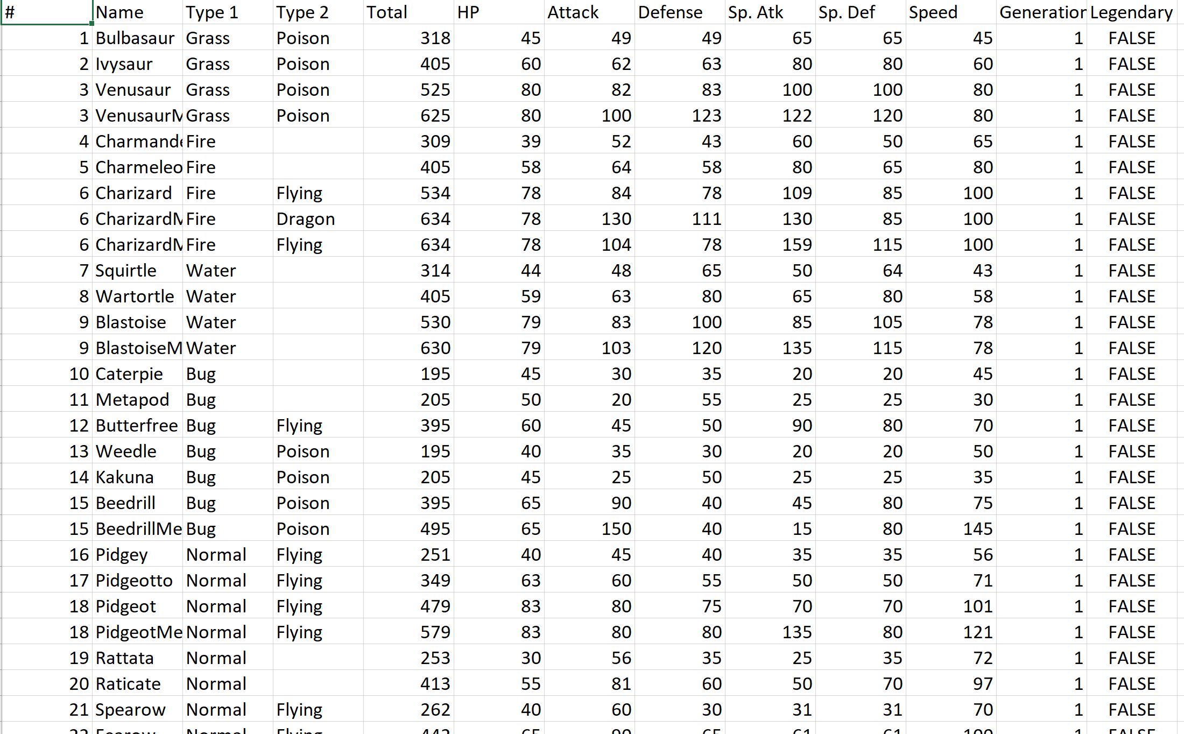
Example of csv file

Slide 5
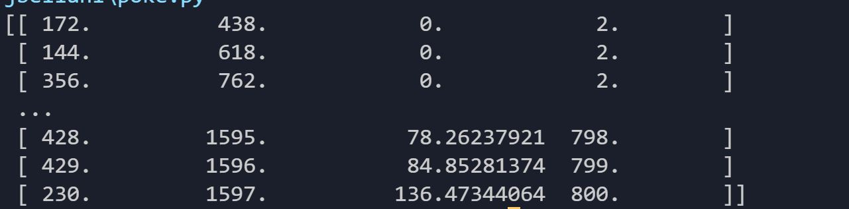
OUTPUT AFTER CLUSTERING

Slide 6
FUNCTIONS USED
load_data(filepath) — takes in a string with a path to a CSV file formatted as in the link above, and returns the first 20 data points in a single structure.
2. calculate_x_y(stats) — takes in one row from the data loaded from the previous function, calculates the corresponding x, y values for that Pokemon as specified above, and returns them in a single structure.
3. hac(dataset) — performs single linkage hierarchical agglomerative clustering on the Pokemon with the (x,y) feature representation, and returns a data structure representing the clustering.

Slide 7
TECHNOLOGIES USED
Python 3.0
Pycharm (compilation)

Slide 8
THANK YOU!

